Slide 1
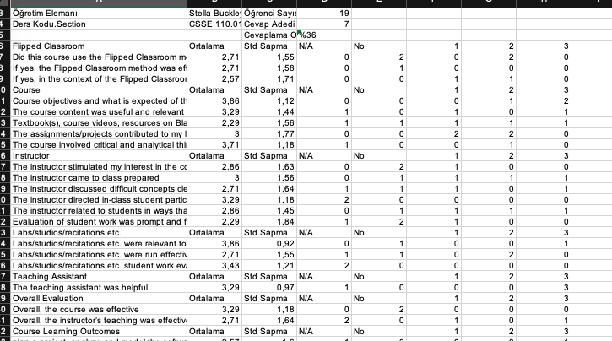
Student Survey ANALYSIS

Slide 2
WHAT IS THE PROBLEM?
In 21st century there are datas about everything.
And It is nearly impossible to get a meaningful data by using human power.
People need to develop computer programs to analyze them fast.
Like end of the semester surveys in a university.
Universities need programs that calculates the significant data from those surveys.

Slide 3
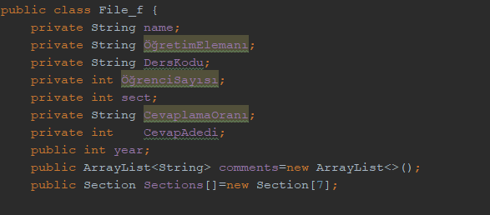
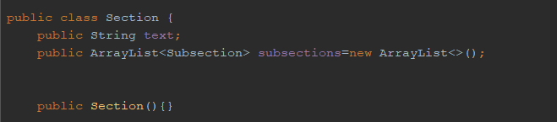
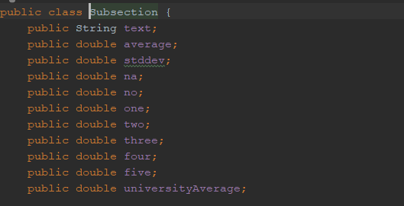
Reading of an excel file
To be able to read .xls file type in java we have to implement POI library.
Firstly we write a proper classes such as File_f which composed of section class and some parameters. And finally section class composed of subsection class.

Slide 4
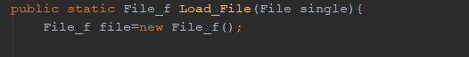
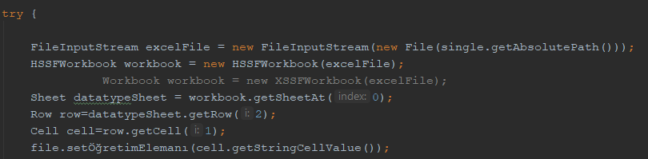
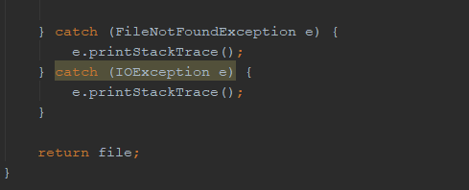
ANALYSING OF A SINGLE EXCEL FILE
To analyze the given single file we write method which takes as a parameter of File object. Then in the function body It open that excel file and reads it. Later store the datas to the acquired objects. Finally returns a File_f object.

Slide 5
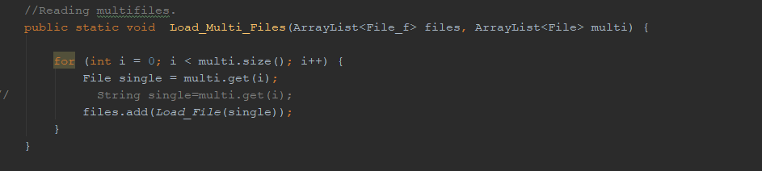
ANALYSING OF MULTI FILE
By the help of the single file method we able to read multiple file. This method takes parameters such that File_f arraylist and File arraylists. It calls single file method until the length of the file list and while that process it fills the object arraylist.

Slide 6
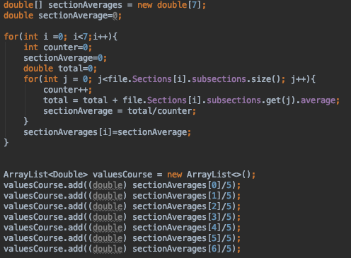
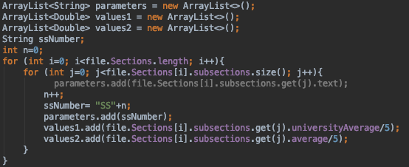
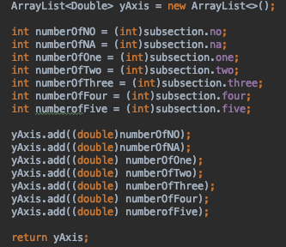
Single file methods
In single file method we analyze the excel file before we write the algorithms for single file.
We decided the most general and most useful methods to write.
To obtain the significant charts from it we combine different charts with different algorithms which we found.

Slide 7
Charts
To create charts we implement the xchart library.
Then we create a basic class for every different chart creation.
We use charts as object and with that creation of a chart was in the chart class.

Slide 8
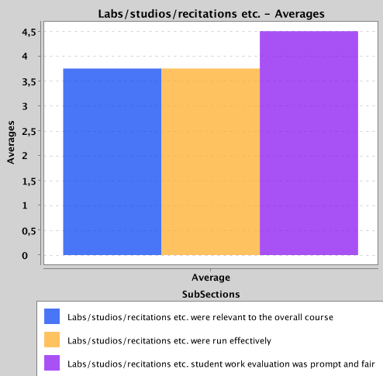
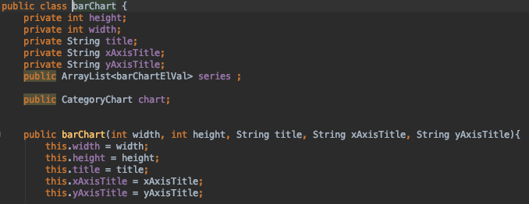

Slide 9
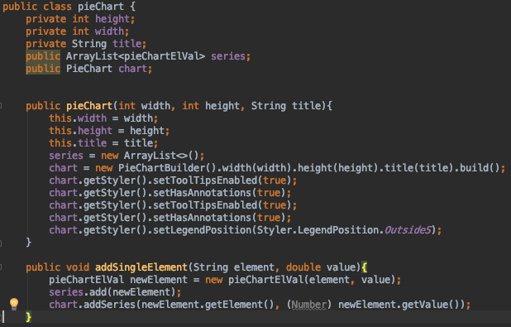
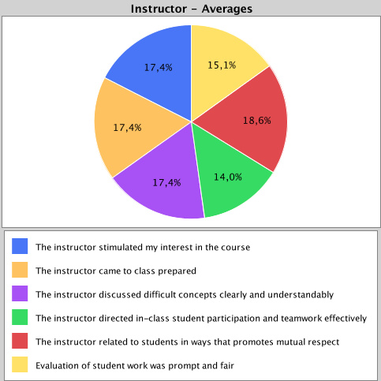

Slide 10
